Slide 1
Chapter 2- Project evaluation and programme management
SOFTWARE
PROJECT MANAGEMENT

Slide 2
Main topics to be covered
The business case for a project
Project portfolios
Project evaluation
  Cost benefit analysis
  Cash flow forecasting
Programme management
Benefits management
Notes:
Topics covered
Professional software development
What is meant by software engineering.
Software engineering ethics
A brief introduction to ethical issues that affect software engineering.
Suggested student projects
A brief introduction to each suggested project that can be carried out by students for this course

Slide 3
The business case
Feasibility studies can also act as a ‘business case’
Provides a justification for starting the project
Should show that the benefits of the project will exceed development, implementation and operational costs
Needs to take account of business risks
Notes:
Topics covered
Professional software development
What is meant by software engineering.
Software engineering ethics
A brief introduction to ethical issues that affect software engineering.
Suggested student projects
A brief introduction to each suggested project that can be carried out by students for this course

Slide 4
Contents of a business case
Introduction/ background
The proposed project
The market
Organizational and operational infrastructure
The benefits
Outline implementation plan
Costs
The financial case
Risks
Management plan
Notes:
Topics covered
Professional software development
What is meant by software engineering.
Software engineering ethics
A brief introduction to ethical issues that affect software engineering.
Suggested student projects
A brief introduction to each suggested project that can be carried out by students for this course

Slide 5
Content of the business case
Introduction/background: describes a problem to be solved or an opportunity to be exploited
The proposed project: a brief outline of the project scope
The market: the project could be to develop a new product (e.g. a new computer game). The likely demand for the product would need to be assessed
Notes:
Topics covered
Professional software development
What is meant by software engineering.
Software engineering ethics
A brief introduction to ethical issues that affect software engineering.
Suggested student projects
A brief introduction to each suggested project that can be carried out by students for this course

Slide 6
Content of the business case
Organizational and operational infrastructure: How the organization would need to change. This would be important where a new information system application was being introduced.
Benefits These should be express in financial terms where possible. In the end it is up to the client to assess these – as they are going to pay for the project.
Notes:
Topics covered
Professional software development
What is meant by software engineering.
Software engineering ethics
A brief introduction to ethical issues that affect software engineering.
Suggested student projects
A brief introduction to each suggested project that can be carried out by students for this course

Slide 7
Content of the business case
Outline implementation plan: how the project is going to be implemented. This should consider the disruption to an organization that a project might cause.
Costs: the implementation plan will supply information to establish these
Financial analysis: combines costs and benefit data to establish value of project
Notes:
Topics covered
Professional software development
What is meant by software engineering.
Software engineering ethics
A brief introduction to ethical issues that affect software engineering.
Suggested student projects
A brief introduction to each suggested project that can be carried out by students for this course

Slide 8
Project portfolio management
The concerns of project portfolio management include:
Evaluating proposals for projects
Assessing the risk involved with projects
Deciding how to share resources between projects
Taking account of dependencies between projects
Removing duplication between projects
Checking for gaps
Notes:
Topics covered
Professional software development
What is meant by software engineering.
Software engineering ethics
A brief introduction to ethical issues that affect software engineering.
Suggested student projects
A brief introduction to each suggested project that can be carried out by students for this course

Slide 9
Project portfolio management
There are three elements to PPM:
Project portfolio definition
  Create a central record of all projects within an organization
  Must decide whether to have ALL projects in the repository or, say, only ICT projects
  Note difference between new product development (NPD) projects and renewal projects e.g. for process improvement
Notes:
Topics covered
Professional software development
What is meant by software engineering.
Software engineering ethics
A brief introduction to ethical issues that affect software engineering.
Suggested student projects
A brief introduction to each suggested project that can be carried out by students for this course

Slide 10
Project portfolio management
Project portfolio management
  Actual costing and performance of projects can be recorded and assessed
Project portfolio optimization
  Information gathered above can be used achieve better balance of projects e.g. some that are risky but potentially very valuable balanced by less risky but less valuable projects
You may want to allow some work to be done outside the portfolio e.g. quick fixes
Notes:
Topics covered
Professional software development
What is meant by software engineering.
Software engineering ethics
A brief introduction to ethical issues that affect software engineering.
Suggested student projects
A brief introduction to each suggested project that can be carried out by students for this course

Slide 11
Cost benefit analysis (CBA)
This relates to an individual project. You need to:
Identify all the costs which could be:
  Development costs
  Set-up
  Operational costs
Identify the value of benefits
Check benefits are greater than costs
Notes:
Topics covered
Professional software development
What is meant by software engineering.
Software engineering ethics
A brief introduction to ethical issues that affect software engineering.
Suggested student projects
A brief introduction to each suggested project that can be carried out by students for this course

Slide 12
Product/system life cycle cash flows
The timing of costs and income for a product of system needs to be estimated.
The development of the project will incur costs.
When the system or product is released it will generate income that gradually pays off costs
Some costs may relate to decommissioning – think of demolishing a nuclear power station
Notes:
Topics covered
Professional software development
What is meant by software engineering.
Software engineering ethics
A brief introduction to ethical issues that affect software engineering.
Suggested student projects
A brief introduction to each suggested project that can be carried out by students for this course

Slide 13
Product/system life cycle cash flows
Income
Time
Expenditure
Notes:
Topics covered
Professional software development
What is meant by software engineering.
Software engineering ethics
A brief introduction to ethical issues that affect software engineering.
Suggested student projects
A brief introduction to each suggested project that can be carried out by students for this course

Slide 14
Net profit
Year | Cash-flow
0 | -100,000
1 | 10,000
2 | 10,000
3 | 10,000
4 | 20,000
5 | 100,000
Net profit | 50,000
‘Year 0’ represents all the costs before system is operation
‘Cash-flow’ is value of income less outgoing
Net profit value of all the cash-flows for the lifetime of the application
Notes:
Topics covered
Professional software development
What is meant by software engineering.
Software engineering ethics
A brief introduction to ethical issues that affect software engineering.
Suggested student projects
A brief introduction to each suggested project that can be carried out by students for this course

Slide 15
Pay back period
This is the time it takes to start generating a surplus of income over outgoings. What would it be below?
Year | Cash-flow | Accumulated
0 | -100,000 | -100,000
1 | 10,000 | -90,000
2 | 10,000 | -80,000
3 | 10,000 | -70,000
4 | 20,000 | -50,000
5 | 100,000 | 50,000
Notes:
Topics covered
Professional software development
What is meant by software engineering.
Software engineering ethics
A brief introduction to ethical issues that affect software engineering.
Suggested student projects
A brief introduction to each suggested project that can be carried out by students for this course

Slide 16
Return on investment (ROI)
  Average annual profit
  ROI = X100
  Total investment
In the previous example
  average annual profit
  = 50,000/5
  = 10,000
  ROI = 10,000/100,000 X 100
  =10%
Notes:
Topics covered
Professional software development
What is meant by software engineering.
Software engineering ethics
A brief introduction to ethical issues that affect software engineering.
Suggested student projects
A brief introduction to each suggested project that can be carried out by students for this course

Slide 17
Net present value
Would you rather I gave you £100 today or in 12 months time?
If I gave you £100 now you could put it in savings account and get interest on it.
If the interest rate was 10% how much would I have to invest now to get £100 in a year’s time?
This figure is the net present value of £100 in one year’s time
Notes:
Topics covered
Professional software development
What is meant by software engineering.
Software engineering ethics
A brief introduction to ethical issues that affect software engineering.
Suggested student projects
A brief introduction to each suggested project that can be carried out by students for this course

Slide 18
Discount factor
Discount factor = 1/(1+r)^{t}
r is the interest rate (e.g. 10% is 0.10)
t is the number of years
In the case of 10% rate and one year
Discount factor = 1/(1+0.10) =
In the case of 10% rate and two years
Discount factor = 1/(1.10 x 1.10) =0.8294
Notes:
Topics covered
Professional software development
What is meant by software engineering.
Software engineering ethics
A brief introduction to ethical issues that affect software engineering.
Suggested student projects
A brief introduction to each suggested project that can be carried out by students for this course

Slide 19
Applying discount factors
Year | Cash-flow | Discount factor | Discounted cash flow
0 | -100,000 | 1,0000 | -100,000
1 | 10,000 | 0,9091 | 9,091
2 | 10,000 | 0,8264 | 8,264
3 | 10,000 | 0,7513 | 7,513
4 | 20,000 | 0,6830 | 13,660
5 | 100,000 | 0,6209 | 62,090
 |  | NPV | 618
Notes:
Topics covered
Professional software development
What is meant by software engineering.
Software engineering ethics
A brief introduction to ethical issues that affect software engineering.
Suggested student projects
A brief introduction to each suggested project that can be carried out by students for this course

Slide 20
Internal rate of return
Internal rate of return (IRR) is the discount rate that would produce an NPV of 0 for the project
Can be used to compare different investment opportunities
There is a Microsoft Excel function which can be used to calculate
Notes:
Topics covered
Professional software development
What is meant by software engineering.
Software engineering ethics
A brief introduction to ethical issues that affect software engineering.
Suggested student projects
A brief introduction to each suggested project that can be carried out by students for this course

Slide 21
Dealing with uncertainty: Risk evaluation
project A might appear to give a better return than B but could be riskier
Could draw up draw a project risk matrix for each project to assess risks – see next overhead
For riskier projects could use higher discount rates
Notes:
Topics covered
Professional software development
What is meant by software engineering.
Software engineering ethics
A brief introduction to ethical issues that affect software engineering.
Suggested student projects
A brief introduction to each suggested project that can be carried out by students for this course

Slide 22
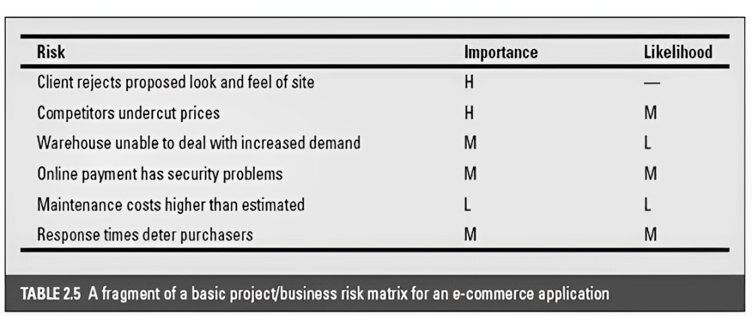
Example of a project risk matrix
Notes:
Topics covered
Professional software development
What is meant by software engineering.
Software engineering ethics
A brief introduction to ethical issues that affect software engineering.
Suggested student projects
A brief introduction to each suggested project that can be carried out by students for this course

Slide 23
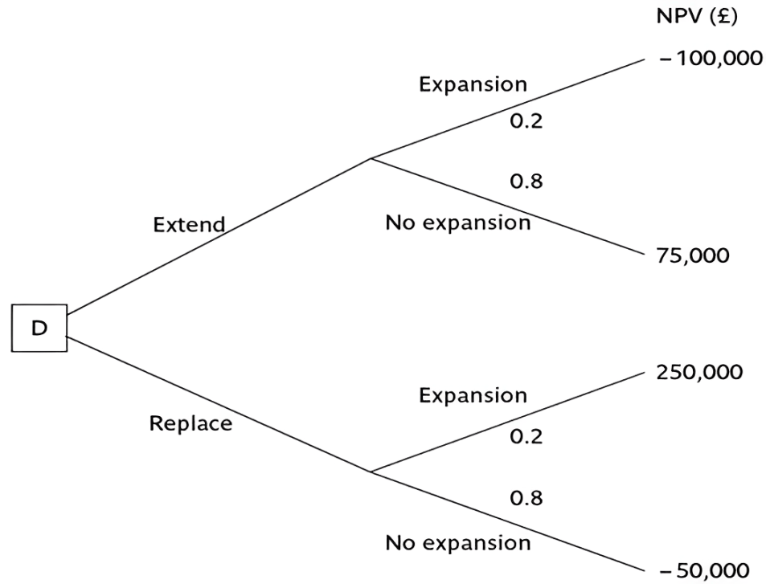
Decision trees
Notes:
Topics covered
Professional software development
What is meant by software engineering.
Software engineering ethics
A brief introduction to ethical issues that affect software engineering.
Suggested student projects
A brief introduction to each suggested project that can be carried out by students for this course

Slide 24
Programme management
One definition:
‘a group of projects that are managed in a co-ordinated way to gain benefits that would not be possible were the projects to be managed independently’
Ferns
Notes:
Topics covered
Professional software development
What is meant by software engineering.
Software engineering ethics
A brief introduction to ethical issues that affect software engineering.
Suggested student projects
A brief introduction to each suggested project that can be carried out by students for this course

Slide 25
Programmes may be
Strategic
Business cycle programmes
Infrastructure programmes
Research and development programmes
Innovative partnerships
Notes:
Topics covered
Professional software development
What is meant by software engineering.
Software engineering ethics
A brief introduction to ethical issues that affect software engineering.
Suggested student projects
A brief introduction to each suggested project that can be carried out by students for this course

Slide 26
Programme managers versus project managers
Programme managers
  Many simultaneous projects
  Personal relationship with skilled resources
  Optimization of resource use
  Projects tend to be seen as similar
Project manager
One project at a time
Impersonal relationship with resources
Minimization of demand for resources
Projects tend to be seen as unique
Notes:
Topics covered
Professional software development
What is meant by software engineering.
Software engineering ethics
A brief introduction to ethical issues that affect software engineering.
Suggested student projects
A brief introduction to each suggested project that can be carried out by students for this course

Slide 27
Strategic programmes
Based on OGC approach
Initial planning document is the Programme Mandate describing
  The new services/capabilities that the programme should deliver
  How an organization will be improved
  Fit with existing organizatioal goals
A programme director appointed a champion for the scheme
Notes:
Topics covered
Professional software development
What is meant by software engineering.
Software engineering ethics
A brief introduction to ethical issues that affect software engineering.
Suggested student projects
A brief introduction to each suggested project that can be carried out by students for this course

Slide 28
Next stages/documents
The programme brief – equivalent of a feasibility study: emphasis on costs and benefits
The vision statement – explains the new capability that the organization will have
The blueprint – explains the changes to be made to obtain the new capability
Notes:
Topics covered
Professional software development
What is meant by software engineering.
Software engineering ethics
A brief introduction to ethical issues that affect software engineering.
Suggested student projects
A brief introduction to each suggested project that can be carried out by students for this course

Slide 29
Benefits management
developers
users
organization
use
for
the application
benefits
build
To deliver
Providing an organization with a capability does not guarantee that this will provide benefits envisaged – need for benefits management
This has to be outside the project – project will have been completed
Therefore done at programme level
Notes:
Topics covered
Professional software development
What is meant by software engineering.
Software engineering ethics
A brief introduction to ethical issues that affect software engineering.
Suggested student projects
A brief introduction to each suggested project that can be carried out by students for this course

Slide 30
Benefits management
To carry this out, you must:
Define expected benefits
Analyse balance between costs and benefits
Plan how benefits will be achieved
Allocate responsibilities for their achievement
Monitor achievement of benefits
Notes:
Topics covered
Professional software development
What is meant by software engineering.
Software engineering ethics
A brief introduction to ethical issues that affect software engineering.
Suggested student projects
A brief introduction to each suggested project that can be carried out by students for this course

Slide 31
Benefits
These might include:
Mandatory requirement
Improved quality of service
Increased productivity
More motivated workforce
Internal management benefits
Notes:
Topics covered
Professional software development
What is meant by software engineering.
Software engineering ethics
A brief introduction to ethical issues that affect software engineering.
Suggested student projects
A brief introduction to each suggested project that can be carried out by students for this course

Slide 32
Benefits
Risk reduction
Economies
Revenue enhancement/acceleration
Strategic fit
Notes:
Topics covered
Professional software development
What is meant by software engineering.
Software engineering ethics
A brief introduction to ethical issues that affect software engineering.
Suggested student projects
A brief introduction to each suggested project that can be carried out by students for this course

Slide 33
Quantifying benefits
Benefits can be:
Quantified and valued e.g. a reduction of x staff saving £y
Quantified but not valued e.g. a decrease in customer complaints by x%
Identified but not easily quantified – e.g. public approval for a organization in the locality where it is based
Notes:
Topics covered
Professional software development
What is meant by software engineering.
Software engineering ethics
A brief introduction to ethical issues that affect software engineering.
Suggested student projects
A brief introduction to each suggested project that can be carried out by students for this course

Slide 34
Remember!
A project may fail not through poor management but because it should never have been started
A project may make a profit, but it may be possible to do something else that makes even more profit
A real problem is that it is often not possible to express benefits in accurate financial terms
Projects with the highest potential returns are often the most risky
Notes:
Topics covered
Professional software development
What is meant by software engineering.
Software engineering ethics
A brief introduction to ethical issues that affect software engineering.
Suggested student projects
A brief introduction to each suggested project that can be carried out by students for this course

